Slide 1

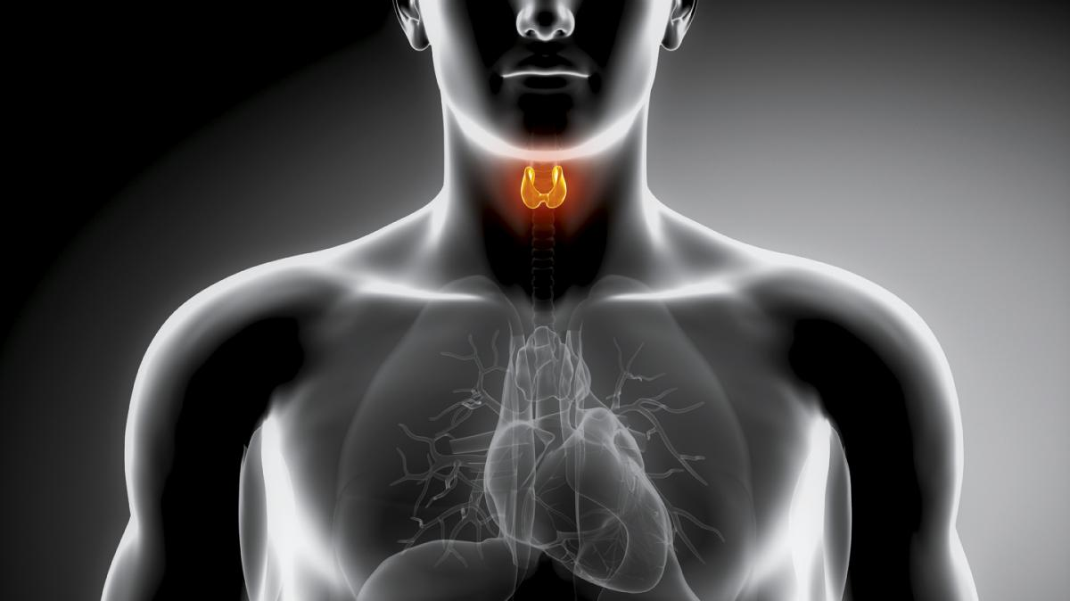
Congenital Hypothyroidism
Derek Scholes, RDN
M3, Class of 2024

Slide 2
Background:
Inadequate thyroid hormone production in the newborn.
Multiple causes:
Anatomic defect in the gland
Inborn error of thyroid metabolism
Iodine deficiency
80-95% thought to be thyroid dysgenesis
May be transient and not permanent

Slide 3


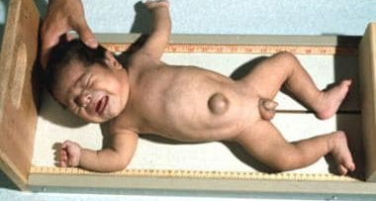

Slide 4
Signs & Symptoms: (“Good babies”)
Profound mental retardation
Delayed motor development
Coarse hair
Protuberant abdomen
Protuberant tongue (macroglossia)
Puffy face
Delayed epiphyseal closure
Short stature
Decreased activity
Jaundice
Hypotonia
Poor feeding/weight gain
Mottled, cool, dry skin
Goiter
Pallor

Slide 5
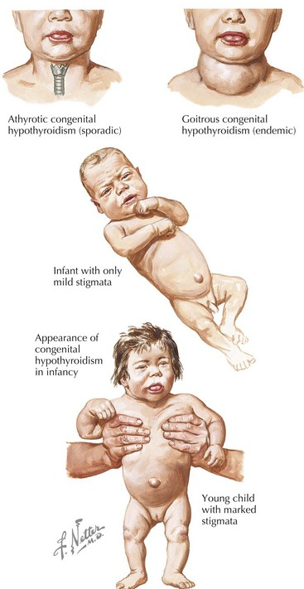
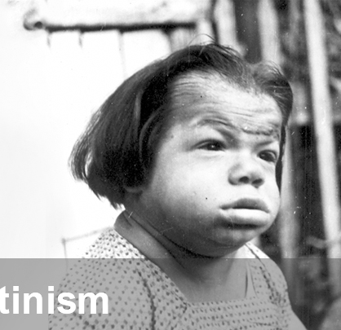

Slide 6
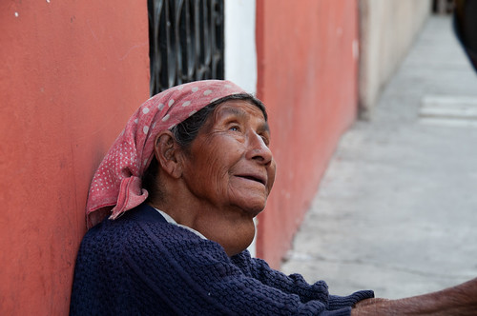
Differentials:
Goiter
Panhypopituitarism
Pediatric Hypopituitarism
Thyroxine-Binding Globulin Deficiency (often doesn’t result in illness)
Iodine Deficiency

Slide 7
Diagnosis/Workup:
Primary TSH with backup thyroxine (T4) with high TSH
Primary T4 with backup TSH with low T4
Simultaneous measurement of both labs
Second screening recommended in:
LBW and VLBW neonates
Infants admitted to NICU
If infant tested within 24hrs of life
Multiple births

Slide 8
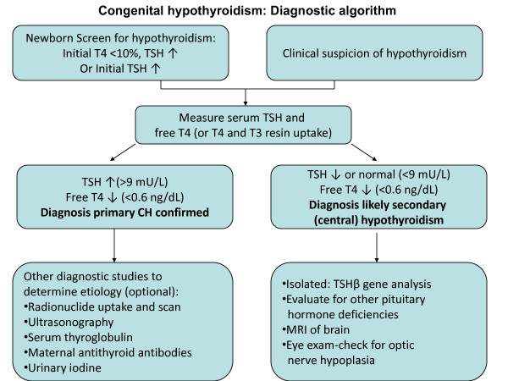

Slide 9
Diagnosis/Workup (cont.):
Neonatal antithyroid antibodies if there is maternal antibody-mediated hypothyroidism
If T4 low but TSH is normal, thyroid binding globulin and free T4 (TBG deficiency has low TBG but normal free T4)

Slide 10
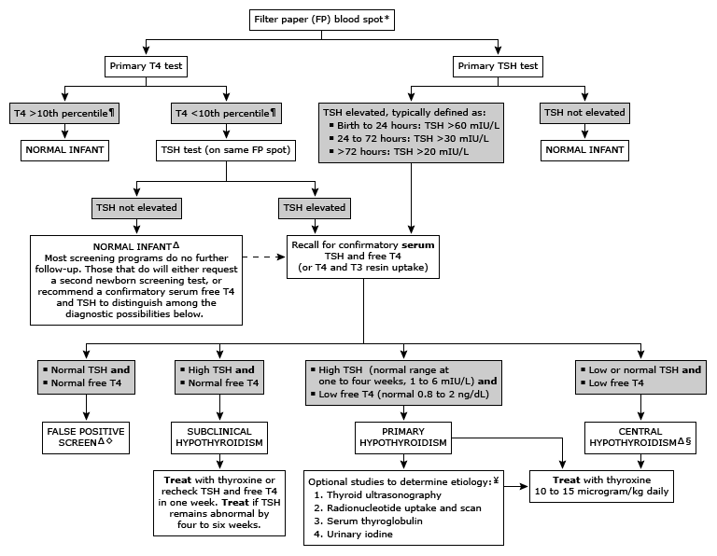
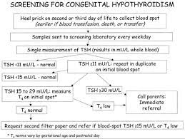

Slide 11
Imaging:
Ultrasonography and Scintigraphy
Anatomy and function
Radiography
Lateral knee (absent ossification center indicates hypothyroidism)

Slide 12
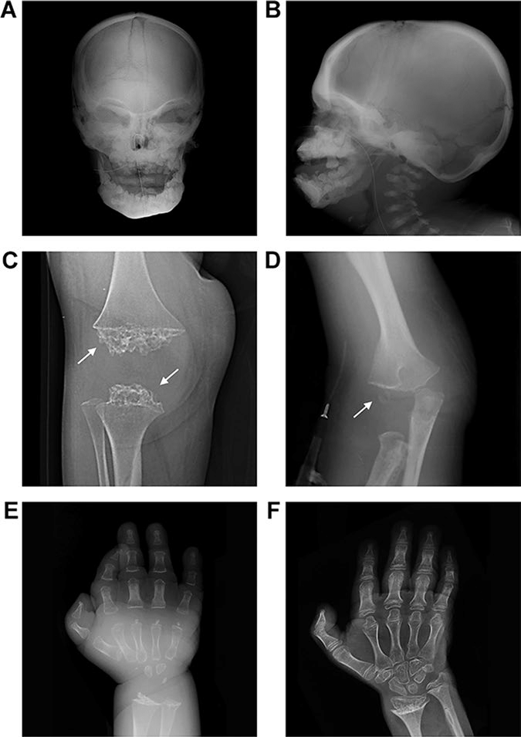
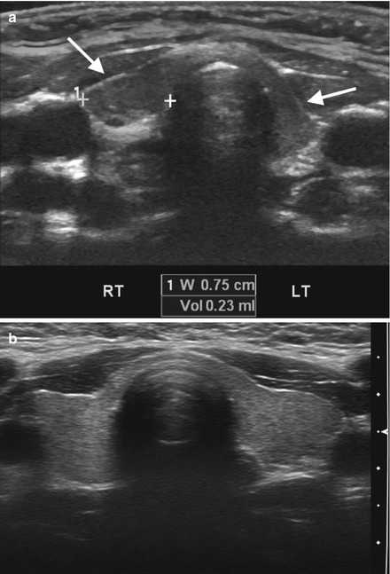

Slide 13
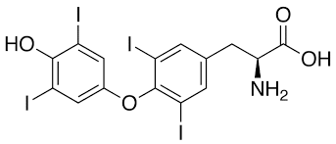
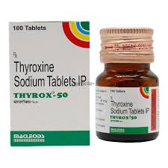
Treatment:
Early diagnosis before 10-13 days
Normalization of hormone levels by 3 weeks
Medication
Levothyroxine
Initial dose: 10-15 mcg/kg/day or ~50mcg in newborns
Pediatric endocrinology consult/referral
Iodide supplementation (also for prevention)

Slide 14
Monitoring:
Total or free T4 and TSH
4-6 weeks after initiation
Every 1-3 months during first year
Every 2-4 months during second and third years
Increase frequency if dosage changes
Developmental and psychoneurological evaluations
School progression w/ early interventions

Slide 15

Thank you!

